Slide 1




Web Search Engines
Dr. Bhuvaneswari A

Slide 2
Questions about the Web
Q: How many computers are in the world? A: Over 40 million.
Q: How many of them are Web servers? A: Over 3 million.
Q: How many Web pages in the world? A: Over 350 million.
Q: What is the most popular formats of Web documents? A: HTML, GIF, JPG, ASCII files, Postscript and ASP.
Q: What is the average size of Web document? A: Mean: 5 Kb; Median: 2 Kb.
Q: How many queries does a search engine answer every day? A: Tens of millions.

Slide 3
Characteristics of the Web
Huge (1.75 terabytes of text)
Allow people to share information globally and freely
Hides the detail of communication protocols, machine locations, and operating systems
Data are unstructured Exponential growth
Increasingly commercial over time (1.5 % .com in 1993 to 60% .com in 1997)

Slide 4
Difficulties of Building a Search Engine
Build by Companies and hide the technical detail Distributed data
High percentage of volatile data Large volume
Unstructured and redundant data Quality of data
Heterogeneous data Dynamic data
How to specify a query from the user
How to interpret the answer provided by the system

Slide 5
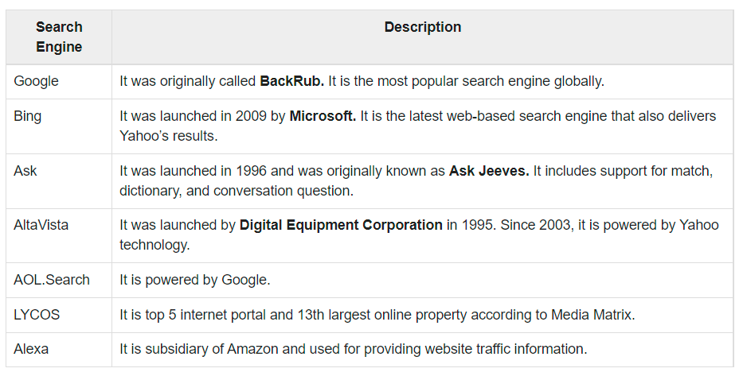

Slide 6
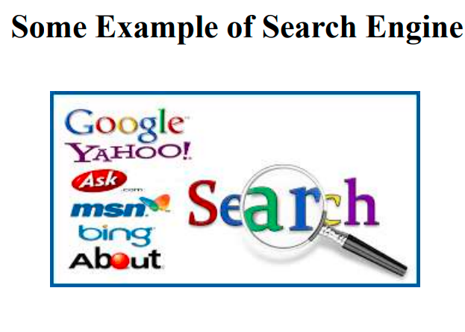

Slide 7
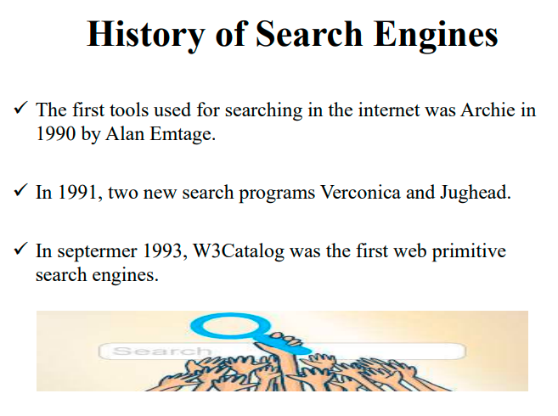

Slide 8
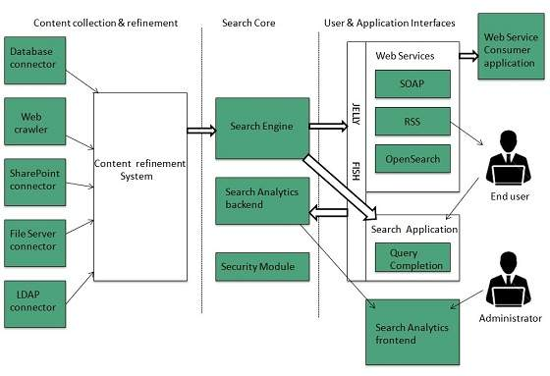
Search Engines Architecture
The search engine architecture comprises of the three basic layers listed below:
Content collection and refinement.
Search core
User and application interfaces

Slide 9
Search Engine Processing
Index Creation
It takes index terms created by text transformations and create data structures to suport fast searching.
Query Process
Query process comprises of the following three tasks:
User interaction, Ranking, Evaluation
User interaction
It supporst creation and refinement of user query and displays the results.
Ranking
It uses query and indexes to create ranked list of documents.
Evaluation
It monitors and measures the effectiveness and efficiency. It is done offline.
Indexing Process
Indexing process comprises of the following three tasks:
Text acquisition
Text transformation
Index creation
Text acquisition
It identifies and stores documents for indexing.
Text Transformation
It transforms document into index terms or features.

Slide 10
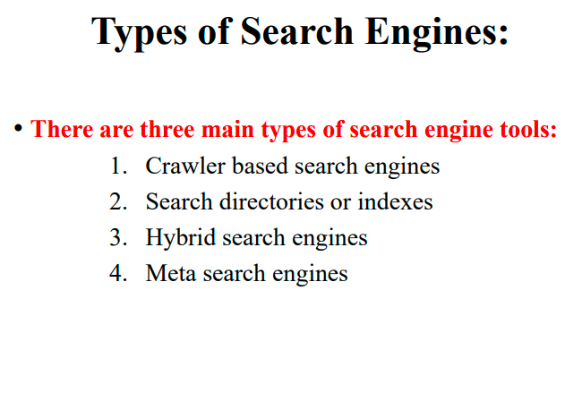

Slide 11
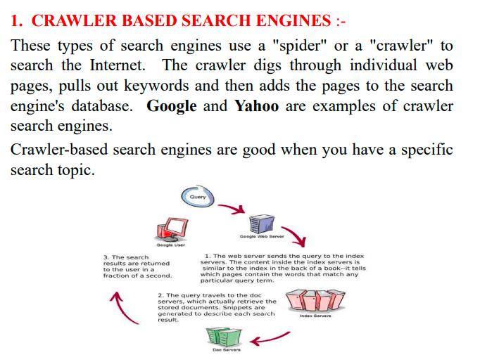

Slide 12
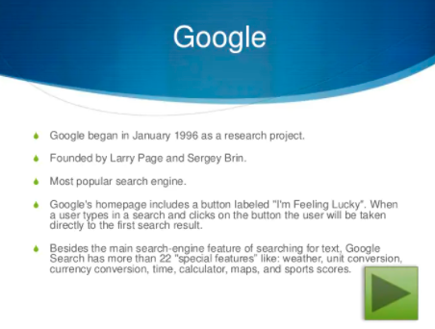

Slide 13
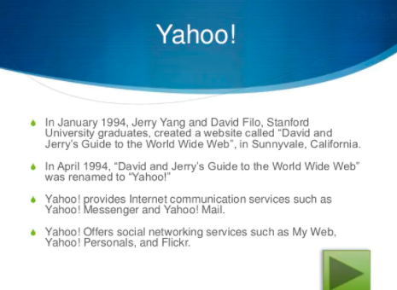

Slide 14
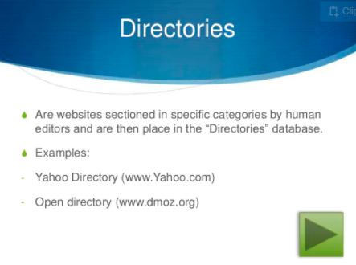

Slide 15
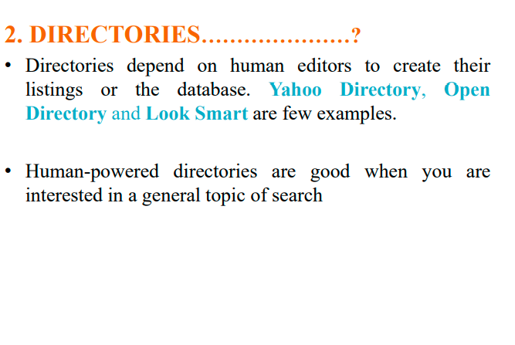
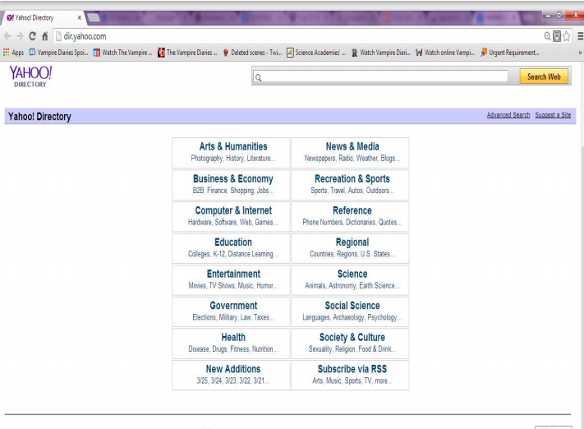

Slide 16
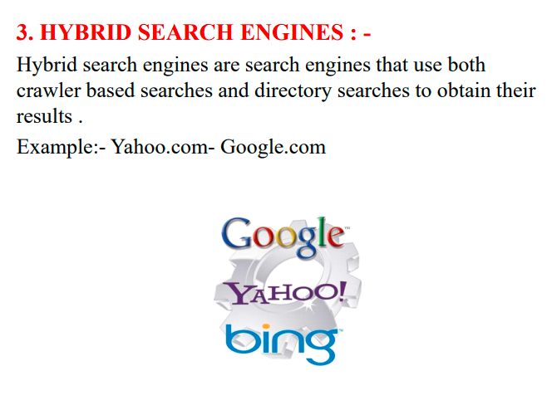

Slide 17
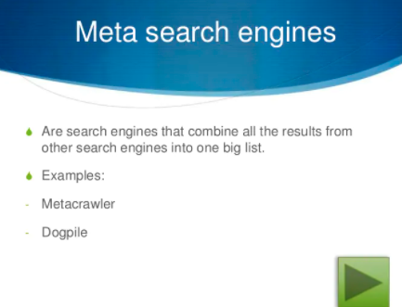

Slide 18
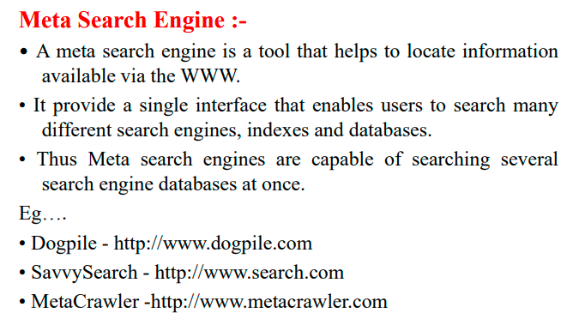

Slide 19
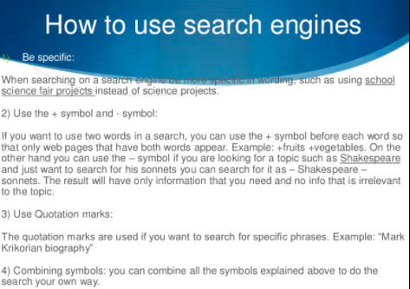

Slide 20
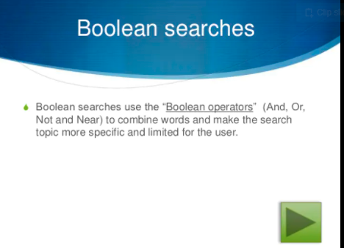

Slide 21
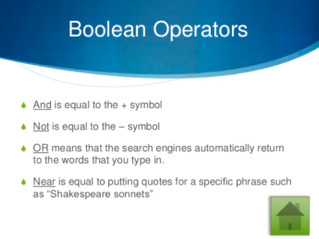

Slide 22
Information Retrieval
Search Engine is in the field of IR
Searching authors, titles and subjects in library card catalogs or computers
Document classification and categorization, user interfaces, data visualization, filtering
Should easily retrieve interested information
IR can be inaccurate as long as the error is insignificant
Data is usually natural language text, which is not always well structured and could be semantically ambiguous
Goal: To retrieve all the documents which are relevant to a query while retrieving as few non-relevant documents as possible

Slide 23
User Problems
Do not exactly understand how to provide a sequence of words for the search
Not aware of the input requirement of the search engine.
Problems understanding Boolean logic, so the users cannot use advanced search
Novice users do not know how to start using a search engine
Do not care about advertisements ? No funding
Around 85% of users only look at the first page of the result, so relevant answers might be skipped

Slide 24
Searching Guidelines
Specify the words clearly (+, -)
Use Advanced Search when necessary Provide as many particular terms as possible
If looking for a company, institution, or organization, try: www.name [.com | .edu | .org | .gov | country code]
Some searching engine specialize in some areas
If the user use broad queries, try to use Web directories as starting points
The user should notice that anyone can publish data on the Web, so information that they get from search engines might not be accurate.

Slide 25
Types of Search Engines
Search by Keywords (e.g. AltaVista, Excite, Google, and Northern Light)
Search by categories (e.g. Yahoo!) Specialize in other languages (e.g. Chinese Yahoo! and Yahoo! Japan)
Interview simulation (e.g. Ask Jeeves!)

Slide 26
The Largest Search Engines
(1998)
Search engine | URL | Web pages indexed
AltaVista | www. altavista.com | 140
AOL Search | search.aol.com | N/A
Excite | www.excite.com | 55
Google | google.stanford.edu | 25
GoTo | goto.com | N/A
HotBot | www. hotbot.com | 110
Go | www.go.com | 30
Lycos | www. lycos.com | 30
Magellan | magellan.excite.com | 55
Microsoft | search.msn.com | N/A
Northern Light | www. northernlight.com | 67
Open Text | www.opentext.com | N/A
WebCrawler | www. webcrawler.com | 2

Slide 27
Search Engine Architectures
AltaVista Harvest Google

Slide 28
AltaVista Architecture
Index
Query Engine
Interface
Indexer
User
Crawler
Web

Slide 29
Harvest Architecture
Replication Manager
Broker
User
Broker
Gatherer
Object Cache
Web site

Slide 30
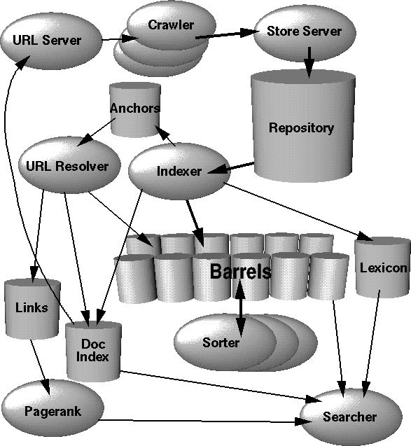
Google Architecture

Slide 31
User Interfaces
Query Interface
A box is entered a sequence of words (AltaVista uses union, HotBot uses intersection)
Complex query interfaces (e.g. Boolean logic, phrase search, title search, URL search, date range search, data type search)
Answer Interface
Relevant pages appear on the top of the list
Each entry in the list includes a title of the page, an URL, a brief summary, a size , a date and a written language

Slide 32
Web Directories
Also called: catalogs, yellow pages, subject directories
Hierarchical taxonomies that classify human knowledge
First level of taxonomies range from 12 to 26 Popularities: Yahoo!, eBLAST, LookSmart, Magellan, and Nacho.
Most allow keyword searches
Category services: AltaVista Categories, AOL Netfind, Excite Channels, HotBot, Infoseek, Lycos Subjects, and WebCrawler Select.

Slide 33
The Most Popular Web Directories in 1998
Web directory | URL
eBLAST | www.eblast.com
LookSmart | www.looksmart.com
Lycos Subjects | www. lycos.com
Magellan | magellan.excite.com
NewHoo | www. newhoo.com
Netscape | search. netscape.com
Search.com | www.search.com
Snap | www.snap.com
Yahoo! | www.yahoo.com

Slide 34
Ranking
Not publicly available
Do not allow access to the text, but only indices
Sometimes too many relevant pages for a simple query
Hard to compare the quality of ranking for two search engines
PageRank, Anchor Text

Slide 35
PageRank
Used by WebQuery and Google Google simulates users using the search engine to rank documents
Google uses citation graph (518 million links) Google computes 26 million in a few hours
Many pages point to the result page ? High ranking
Some high-ranking pages point to the result page ?
High ranking

Slide 36
Anchor Text
Most search engines associate the text of a link with the page that the link is on
Google is the other way around
Advantages: more accurate descriptions of Web pages and document can be indexed 259 million anchors
Idea was originated by WWWW (World Wide Web Worm)

Slide 37
Other Features
Keep track of location information for all hits
Keep track of visual presentation (e.g. font size of words)

Slide 38
Web Crawlers
Software agents that traverse the Web sending new or updated pages to a main server where they are indexed
Also called robots, spiders, worms, wanders, walkers, and knowbots
The 1st crawler, Wanderer was developed in 1993 Not been publicly described
Runs on local machine and send requests to remote Web servers
Most fragile application
Breath-first and depth-first manner Avoid crawling same pages
Web pages change dynamically Invalid links: 2% to 9%
Fastest crawlers are able to traverse up to 10 million pages per day

Slide 39
Google Crawler
Fast distributed crawling system How does it work?
Peak speed: > 100 pages/sec or 600k per sec for 4 crawlers
Use DNS cache to avoid DNS look up Each connection possible states:
Looking up DNS Connecting to host
Sending request Receiving response
Crawling problems

Slide 40
Internet Archive
Uses multiple machines
A crawler is a single thread Each crawler assigns to 64 sites
No site is assigned to more than one crawler
Each crawler reads a list of URLs into per-site queues
Each crawler uses asynchronous I/O to fetch pages from these queues in parallel
Each crawler extracts the links inside the downloaded page
The crawler assigns links to appropriate site queues

Slide 41
Indices
Use inverted files
Inverted file is a list of sorted words Each word points to related pages
A short description associates with each pointer
500 bytes for description and pointer Store answer in memory
Reduce size of files to 30%
Use binary search for searching for a single keyword
Multiple keyword searching requires multiple binary search independently, then combine all the result
Phrase search is unknown in public
Phrase search is to search words near each other

Slide 42
Metasearchers
A Web server that takes a given query from the user and sends it to several sources
Collect the answer from these sources Return a unified result to the user
Able to sort by host, keyword, data, and popularity
Can run on client machine as well Number of sources is adjustable

Slide 43
Metasearchers in 1998
Metasearcher | URL | Sources used
C4 | www.c4.com | 14
Dogpile | www.dogpile.com | 25
Highway61 | www.highway61.com | 5
InFind | www. infind.com | 6
Mamma | www.mamma.com | 7
MetaCrawler | www. metacrawler.com | 7
MetaMiner | www.miner.uol.com.br | 13
Local Find | local.find.com | N/A

Slide 44
Inquirus
Developed by NEC Research Institute Download and analyze Web pages
Display each page with highlighted query terms in progressive manner
Discard non-existing pages Not publicly available

Slide 45
Savvy Search
Available in 1997, but not now
Goal #1: maximize the likelihood of returning good links
Goal #2: minimize computational and Web resource consumption
Determines which search engines to contact and in what order
Ranks search engines based on query terms and search engines performance

Slide 46
STARTS
Stanford Protocol Proposal for Internet Retrieval and Search
Supported by 11 companies
Facilitates the task of querying multiple document sources
Choose the best sources to evaluate a query
Submit the query at these sources
Merge the query results from these sources

Slide 47
STARTS Protocol
The Query-Language Problems The Rank-Merging Problem The Source-Metadata Problem

Slide 48
Add-on Tools: Alexa
Free: www.alexa.com Appear as a toolbar in IE 5x
Provide useful information about the sites Allow users to browse related sites
Perform searches within the Web site, related site or the whole Web
Shop online Provide popularity
Provide speed of access Provide freshness
Provide overall quality from Alexa users

Slide 49
Future Work
Provide better information filtering
Pose queries more visually
New techniques to traverse the Web due to Web’s growth
New techniques to increase efficiency
Better ranking algorithms
Algorithms that choose which pages to index
Techniques to find dynamic pages which are created on demand
Techniques to avoid searching for duplicated data
Techniques to search multimedia documents on the Web
Friendly user interfaces
Standard protocol to query search engines
Web mining
Developments of reliable and secure intranet

Slide 56
Conclusion

